Slide 1
Is There A Housing Bubble?
Presented By Barry Habib

Slide 2
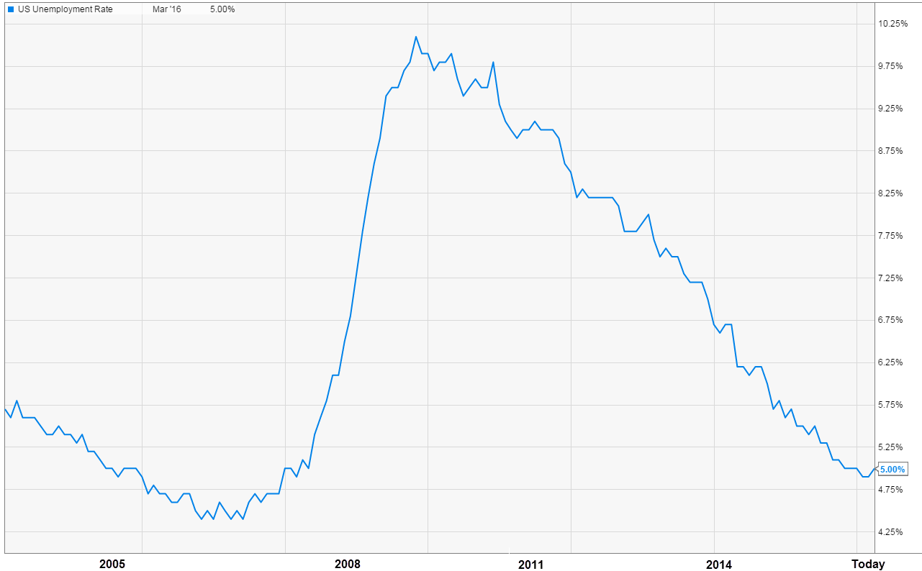
Unemployment Rate During Bubble
US Unemployment
Rate (2005-2016)
Housing Bubble = 7.3%
Today = 5%

Slide 3
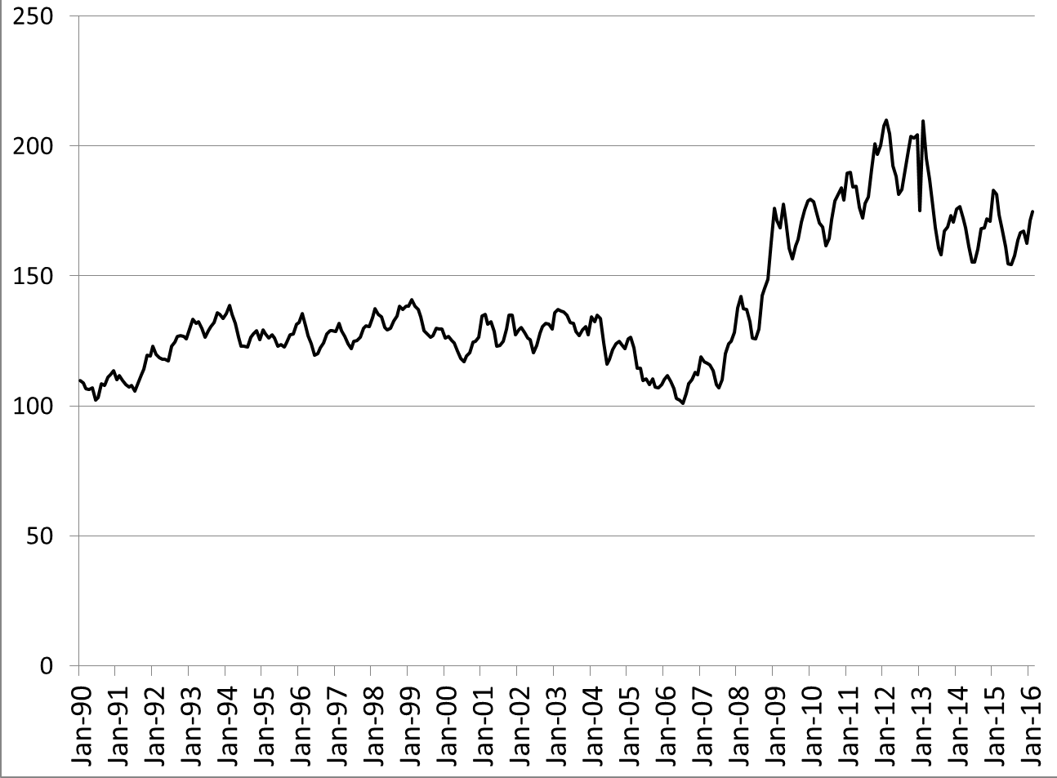
Is Housing Affordable?
US Affordability Index (1990-2016)
Most Affordable Ever - 208
Now -
175
Housing Bubble - 100

Slide 4
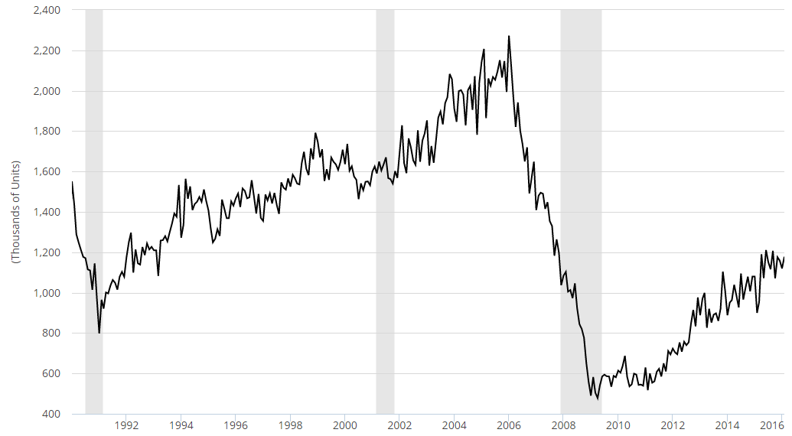
Media Wants 2 Million Starts Again
Housing Starts (2000-2016)
2.2 Million Starts = Housing Bubble
1.2 Million Starts = Healthy

Slide 5
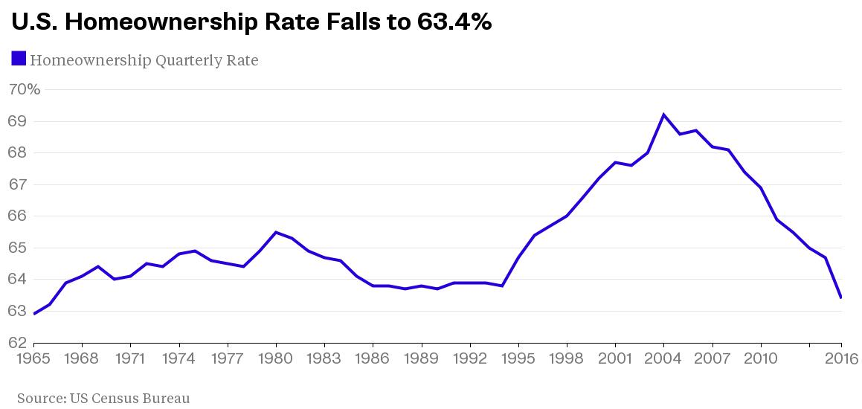
Homeownership Rates
Housing Bubble -
Nearly 70%
Now -
Only 63%

Slide 6
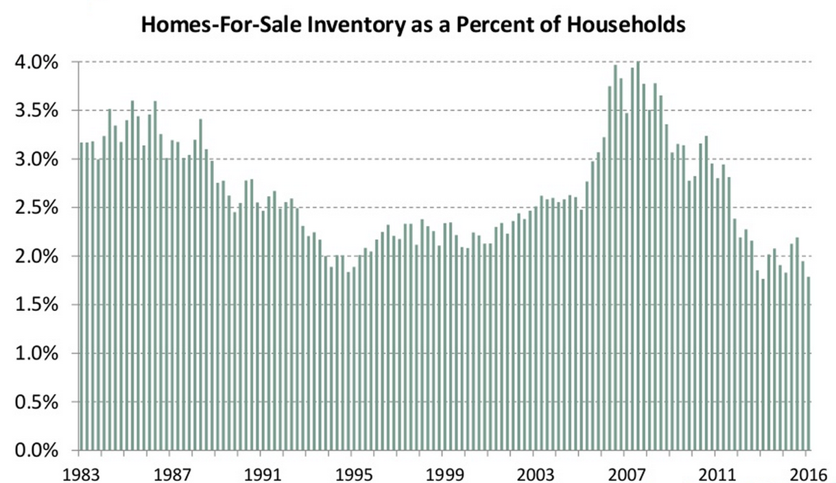
Inventory
Oversupply = Housing Bubble
Nearly Half Inventory
1994

Slide 7
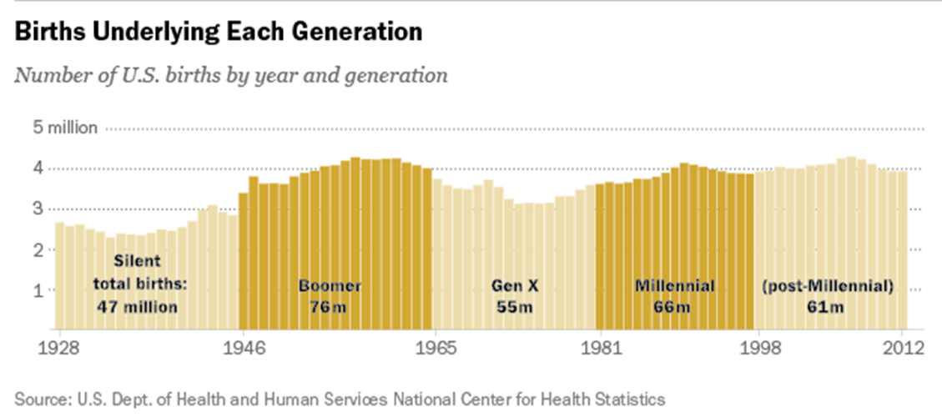
The Next Wave

Slide 8
Is 5% Appreciation Sustainable?
Mortgage Payment
Income
$1,000/Month
$5,000/Month
5% Rise in Price
Up 1%
$1,050/Month
$5,050/Month
And we are seeing Incomes rise by 2.5%

Slide 9
Quality of Loans
Housing Bubble
580 Fico
100 LTV
No Income Verification
Today
High Quality Underwriting Guidelines
Could Argue Too Strict

